Slide 1


Beyond Z Factor: New Methodologies to Distill High Throughput Screening Data
Luca Vedovelli
Unit of Biostatistics, Epidemiology, and Public Health
University of Padova
Luca.Vedovelli@ubep.unipd.it

Slide 2

Introduction
HTS data

Slide 3
The Landscape of High-Throughput Screening in Pharmaceutical Research
Definition: High-Throughput Screening (HTS) is a method for scientific experimentation especially relevant in drug discovery where automated systems are used to rapidly test thousands to millions of samples.
Role: Serves as an initial step in drug discovery to identify candidate compounds that modify a particular biochemical or cellular process.
Historical Context: Originated in the late 20th century, evolving from manual processes to sophisticated automated systems.
Macarron, R., et al. (2011). Impact of high-throughput screening in biomedical research. Nature Reviews Drug Discovery, 10(3), 188-195.
Notes:
HTS stands as a transformative approach in pharmacological research, essentially serving as the 'front gate' for the drug development pipeline.
It allows researchers to rapidly sift through large chemical libraries to pinpoint potential new drugs.

Slide 4
Importance of HTS in Drug Discovery
Quantitative Metrics: Z' factor, S/N ratio, Coefficient of Variance, etc., for assessing the quality and reliability of the assay.
Hit Identification: Crucial for finding "hits" or lead compounds that show a desired biological activity.
Target Validation: HTS data can be repurposed for validating the biological targets of selected hits.
Mayr, L. M., & Bojanic, D. (2009). Novel trends in high-throughput screening. Current Opinion in Pharmacology, 9(5), 580-588.
Notes:
The integration of HTS with bioinformatics and advanced data analytics offers a paradigm shift.
It is not merely a sieve for candidate selection but also a powerful tool for mechanistic understanding and validation.

Slide 5
Challenges and Limitations in HTS
Data Reliability: Issues with false positives and negatives are common.
Data Complexity: With increasing throughput, the complexity and volume of data also increase, demanding sophisticated analytics.
Bleicher, K. H., Böhm, H. J., Müller, K., & Alanine, A. I. (2003). Hit and lead generation: beyond high-throughput screening. Nature Reviews Drug Discovery, 2(5), 369-378.
Notes:
As data generation scales, so does the need for data quality control and interpretation.
Hence, statistical and machine learning methods are becoming indispensable for extracting meaningful insights from HTS data.

Slide 6

Traditional Metrics and Their Limitations
Z' factor and other metrics are commonly used to assess data quality and reproducibility in high-throughput screening (HTS).
However, they struggle to address useful information when the data distribution is not normal or homogeneous, a prevalent issue in HTS.
A traditional reliance on metrics like Z' factors may hinder our understanding of complex HTS data.
Notes:
Z’factor and other metrics struggle to address useful information when the data distribution is not normal or homogeneous e.g., screening of drugs on cells like an Operetta output where cells response is usually not normally distributed and very variable even in the replicates.

Slide 7

Real-World Scenarios
In applied pharmaceutical research, finding "hits," or drugs that are effective, is the main goal.
Theory often falls short of capturing the nuances present in real-world datasets.
"Let’s speak about real research scenarios. Not theory."

Slide 8

The Goal
Our goal is to find HITS, drugs that works
Often, we don’t really care how we get to them

Slide 9
The Messy Data Reality
We get messy data. Almost never we are in ideal situation where:
we have low variability among replicates
the hit drugs measures are well above the non-active ones
negative controls are really negative
positive controls behaves like the hits
birds are chirping
the air is warm, and no one have to work on weekends.

Slide 10
The Messy Data Reality
Advanced statistical methods and machine learning algorithms offer avenues for making the most out of imperfect data.
The "garbage in, garbage out" principle holds, but new tools may help overcome these challenges.

Slide 11

The Scenario

Slide 12

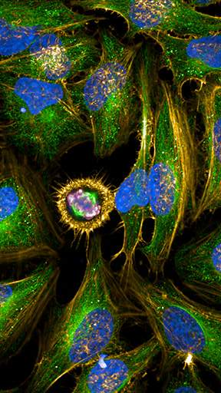
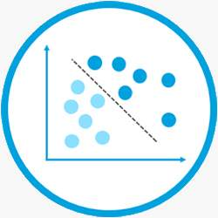
Complexity of the Data
A real-world example involves the analysis of 650 drugs with 3 replicates, 2 cell lines, positive and negative controls, and 15 fluorescence measures from an Operetta device.
This dataset encapsulates the multi-faceted challenges commonly encountered in HTS studies, making it an ideal case for evaluation.

Slide 13

Challenges in Data Interpretation
How to select hits from this data? Options range from sorting measures to praying for consistent controls.
"Pick all the measures and sort it, the hits will be in the top 20 of all the 5 measures! “
In your dreams!

Slide 14

Challenges in Data Interpretation
Standard deviations?
All different in all the measures (VERY different, like: 1, 3, 5, 3, 7)

Slide 15


Challenges in Data Interpretation
Let’s pray for a decent distribution on at least few measures, please…

Slide 16


Challenges in Data Interpretation
"I beg you controls, be really positive and really negative...“
Of course we are! But don’t forget our internal variation that is quite wide.
… I cry

Slide 17


Consequences
Is there really the option to tell the lab guys that they screwed up and not get the tires of your car ripped up like fettuccine? If yes, tell me.
One might be tempted to attribute challenges to lab errors, but even the most diligent lab work can produce complex and messy data.
Notes:
BTW, they don’t make mistakes. They are perfect, they are the very best people in the world. Hello guys!

Slide 18

Possible solutions?
So, what to do to bring out something meaningful from these kinds of data being robust enough as to not get (too much) false hits o to miss too much of them?
The philosophy to approach it will be to use all the information coming from the dataset.
Partial data, gives partial results

Slide 19

Drug Hit Datasets
Drug hits datasets are ‘strange’ . You have a lot of subjects and a relatively small number of variables but from these datasets you expect that the subjects are not similar to each other.
These datasets challenge conventional statistical approaches because each drug is expected to have unique properties, a fundamental departure from traditional epidemiological data analysis

Slide 20

The Groups approach
"You can think that you have two groups: one very small and one very large"

Slide 21

Unsupervised Clustering
The first natural approach then can be unsupervised clustering
While this can provide a broad overview, it's not the final word in identifying hits, especially given the risks of misclassification and 'phantom clusters'.

Slide 22
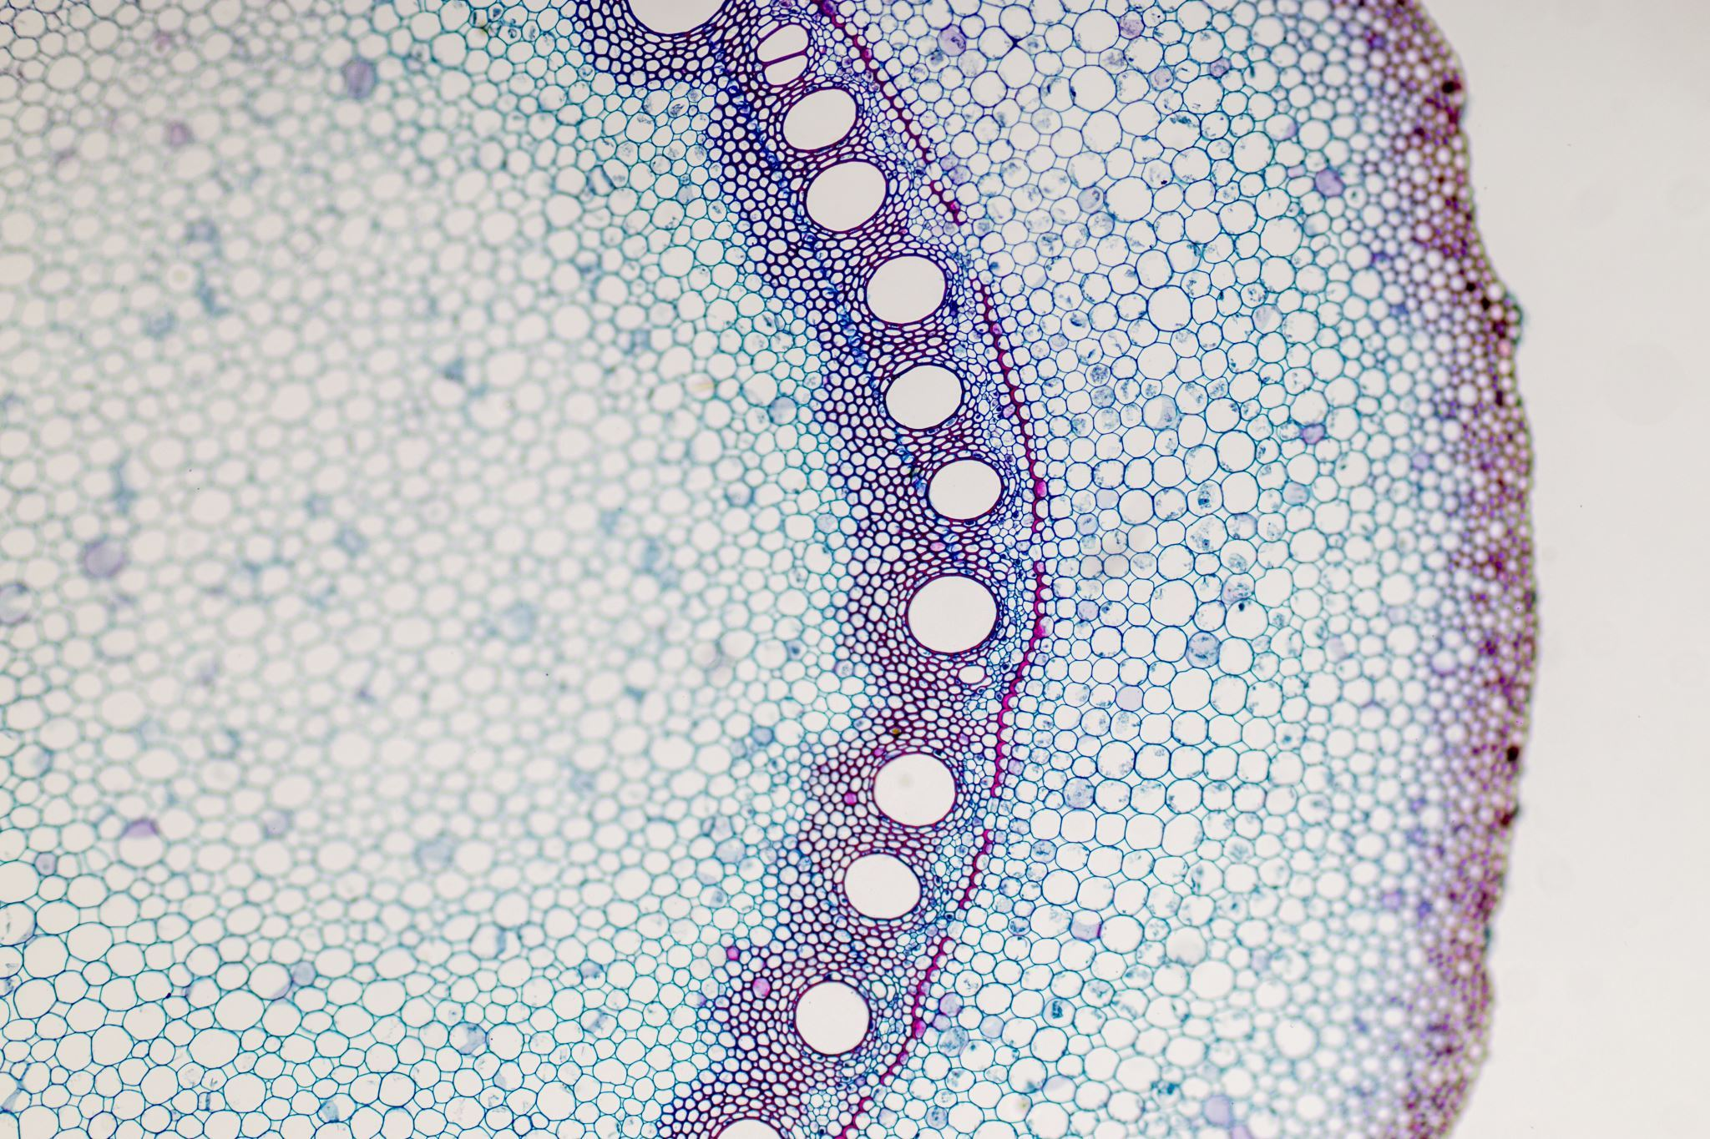
FRANK Harrell’s opinion

Slide 23
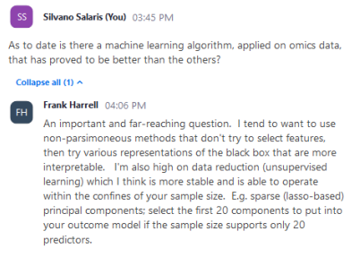
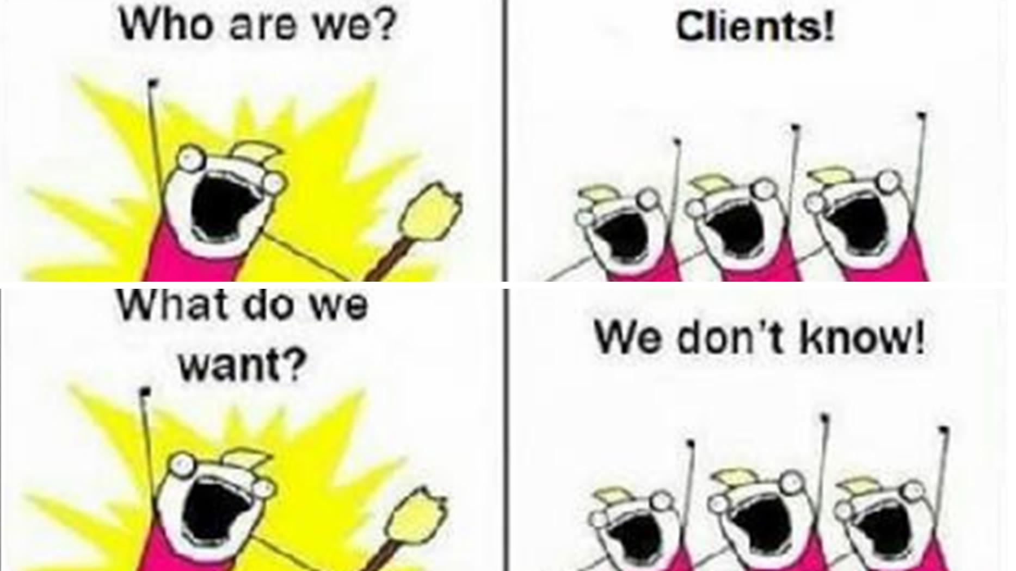
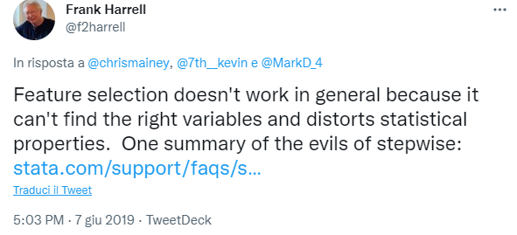
Features selection
Notes:
A more technical problem in omics-like data analysis is the uncontrollable desire to make sense of the data by asking the computer to extract "the most useful features" in the dataset. This is called feature selection and, if not conducted properly is a bad idea. So bad that you can risk giving away all the information and money spent because the model you apply is unreliable. As demonstrated time and again by one of the best living statisticians, Professor Frank Harrell, answering the excellent question from our doctoral student, still observes that:
Feature selection when you have more variables than cases is known to be unreliable, but most biomedical researchers are unaware of the magnitude of the problem. They assume, for example, that setting a false discovery rate will make the results reliable, forgetting the false negative rate and decades of research showing the unreliability of stepwise variable selection even when the number of variables to be selected is low. Professor Harrell suggests maintaining the complexity of the data, using different visualization techniques and then applying knowledge from the field to identify which might be good candidates for further testing. The process is, as you can imagine, astronomically longer and more tedious than clicking a button and letting the computer do all the work, but the probability of doing something wrong with the fastest option is so high that errors are almost sure to happen.

Slide 24

PCA for Variability Separation
PCA retains all the information and is deterministic & interpretable
However, its linear nature and sensitivity to outliers may limit its utility in complex biological datasets, as well as in HTS data

Slide 25

COOL Clustering methods
"What about more sophisticated clustering algorithms?“
UMAP (Uniform Manifold Approximation and Projection) is becoming increasingly popular, especially in single-cell sequencing, another high-throughput method.

Slide 26
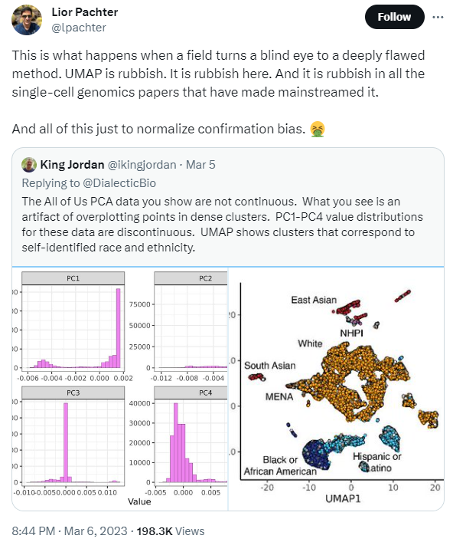
UMAP
Not deterministic
Local structures only are preserved
Hyperparameters selection (straightforward) influences the clustering
Notes:
UMAP has gained widespread popularity in single-cell analysis primarily for its capacity to effectively reduce dimensionality while preserving local but not global structures. Its computational efficiency, flexibility in distance metrics, and compatibility with downstream analyses make it particularly well-suited for large, complex single-cell datasets. These features, along with its community-driven improvements and straightforward hyperparameter tuning, contribute to its current status as a favored tool in the single-cell analytics landscape. But...

Slide 27
Density-Based Methods
Density-Based Spatial Clustering of Applications with Noise (DBSCAN) can identify arbitrarily shaped clusters and isolate outliers
However, a major drawback in applying DBSCAN to HTS is the risk of detecting 'phantom clusters,' especially when the density differences are not well-defined

Slide 28

Model-Based Methods
Gaussian Mixture Models (GMMs) assign each data point to a specific Gaussian distribution, thus allowing a probabilistic model-based clustering
A limitation is that GMMs may not perform well when the data violate the Gaussian assumption, a situation common in HTS

Slide 29
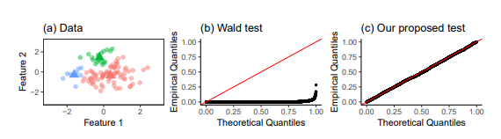
Phantom Clusters
For most of them, the problem is that they can detect phantom clusters
Methods like the ones proposed by Lucy Gao and Daniela Witten can help in determining if identified clusters are "real"
These statistical tests provide an empirical framework to test the veracity of clusters, aiding in the selection of potential 'hits' in HTS.
Gao, L., & Witten, D. (2020). A statistical framework for testing the existence of clusters. Journal of the American Statistical Association.
Notes:
(a) A simulated data set from (1) with µ = 0100×2 and σ 2 = 1. We apply average linkage hierarchical clustering to get three clusters. The empirical means (defined in (2)) of the three clusters are displayed as triangles. QQ-plots of the Uniform(0, 1) distribution against the p-values from (b) the Wald test in (4) and (c) our proposed test, over 2000 simulated data sets from (1) with µ = 0100×2 and σ 2 = 1. For each simulated data set, a p-value was computed for a randomly chosen pair of estimated clusters.

Slide 30
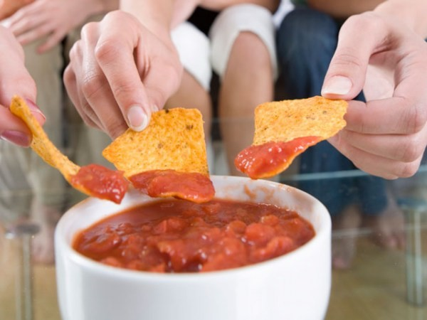
Double Dipping Fallacy
The fallacy of "double dipping" arises when the same data are used both to construct and to validate clustering, leading to overly optimistic results
It's crucial to separate training and validation sets to avoid this fallacy and to gain a realistic understanding of your model's performance
Notes:
In conclusion, you can try them in the beginning but do not expect to end the analysis there of to have useful insights from them, and if you think you have some, take them carefully before going back to the lab guys to test the hits (remember your tires…)

Slide 31

What About Modelling?

Slide 32
Introduction to Modelling
“Modelling is the art of making sense of the data apparent randomness."
It’s the fine tuning between accuracy and prediction ability, walking the crest between the cliff of overfitting and the abyss of deception
Notes:
Modelling is the art of making sense of the data apparent randomness (this is mine, you can quote me, you are welcome).
It’s the fine tuning between accuracy and prediction ability, walking the crest between the cliff of overfitting and the abyss of deception (mine too, I should write a book of statical Haikus).

Slide 33

Objective of Modelling
The idea is to make a model that is able to discriminate between what is a hit and what is not.
Simple as it sounds.
To test a model properly and easily we need a dataset where we already have the results, so we can test it against the ground truth

Slide 34
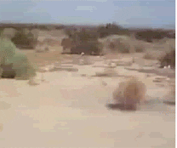
Ground Truth
Who wants to share her raw data in a machine-readable format to everyone for free after spending some ks of company money?
Notes:
Tumbleweed in the desert rolling…

Slide 35

Let’s simulatE!

Slide 36

SIMULATION
In the absence of ground truth, simulation studies can be highly instructive for model validation
Simulations allow for controlled conditions and known ground truth, facilitating a more systematic analysis of model performance.

Slide 37

Naïve Example
This is a naïve example with models tried more or less out of the box
No fine tuning
Probably some errors

Slide 38

But...
The generated dataset is NOT naïve and is the best I could squeeze my brain to have a real-lab example. Not a classic simulation dataset
They are very easy to implement even for less experienced users
A good starting point

Slide 39

But...
Results can probably be improved for almost all of them with fine tuning
They are free to play! (code + github repo provided)
They are free to use and reuse! You even don’t have to cite me.
https://github.com/lucavd/2023.HTS_presentation
Notes:
Results can probably be improved for almost all of them with fine tuning (but who has time for that?)

Slide 40
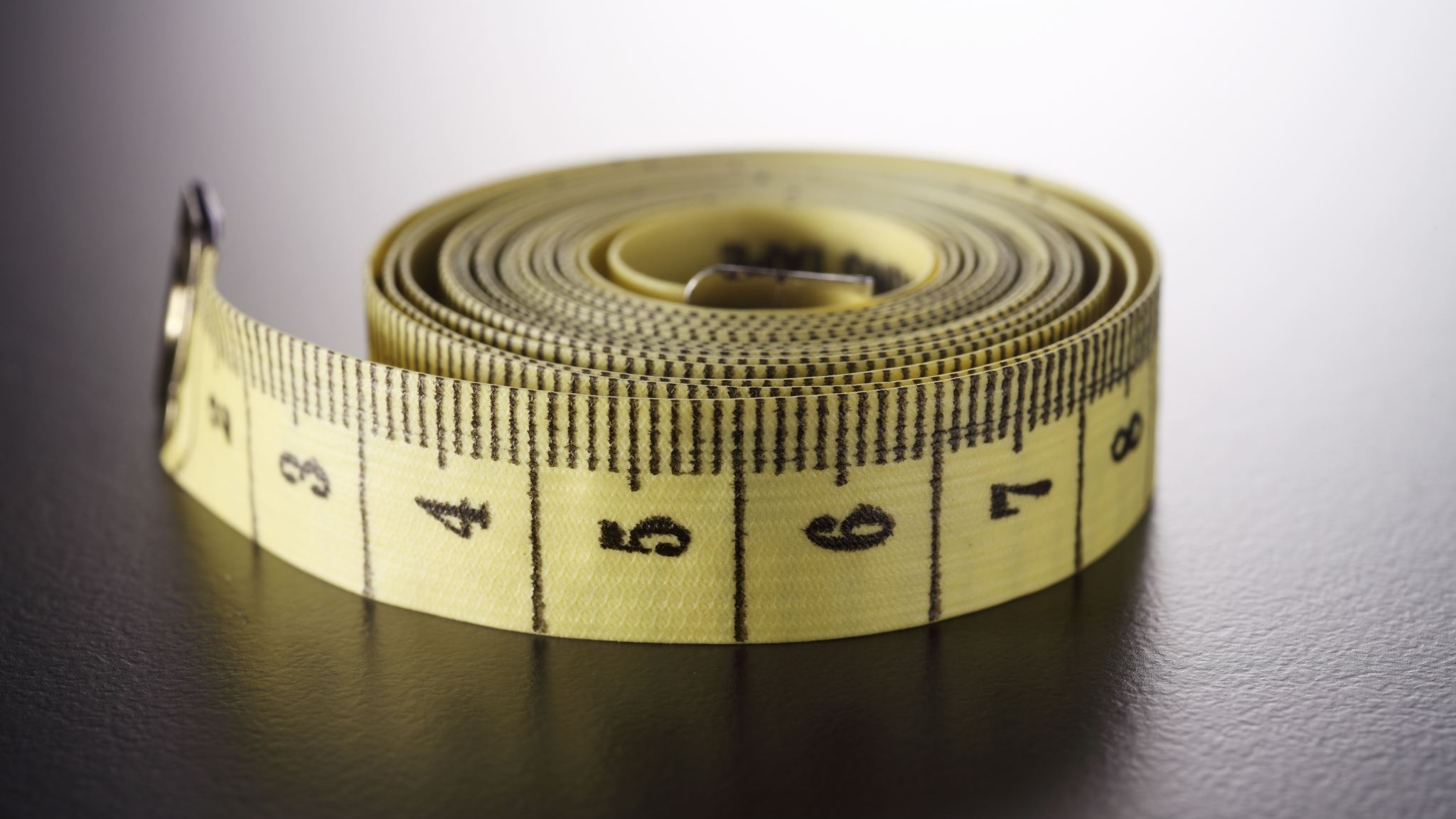
DATA generation and models

Slide 41
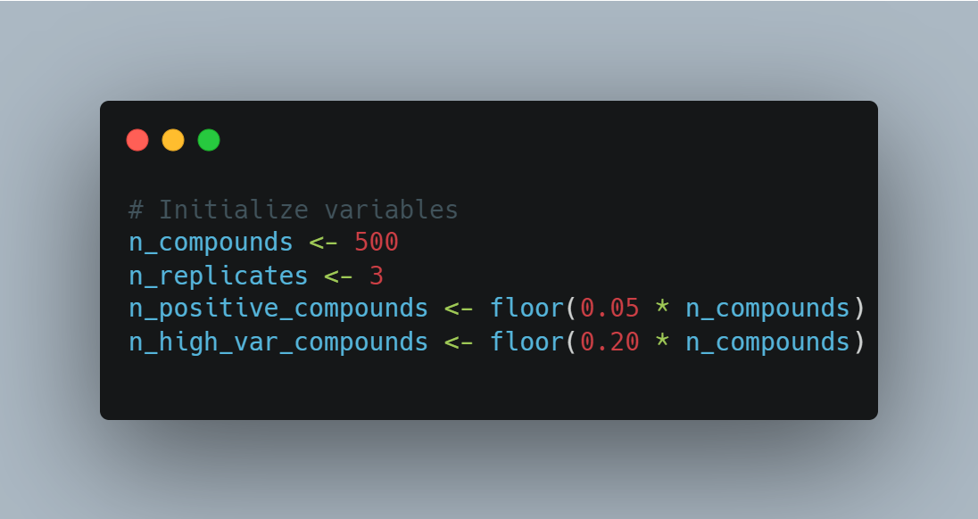
Data Generation
Notes:
- 500 compounds
- 3 replicates
- 5% of the measures are HITS

Slide 42
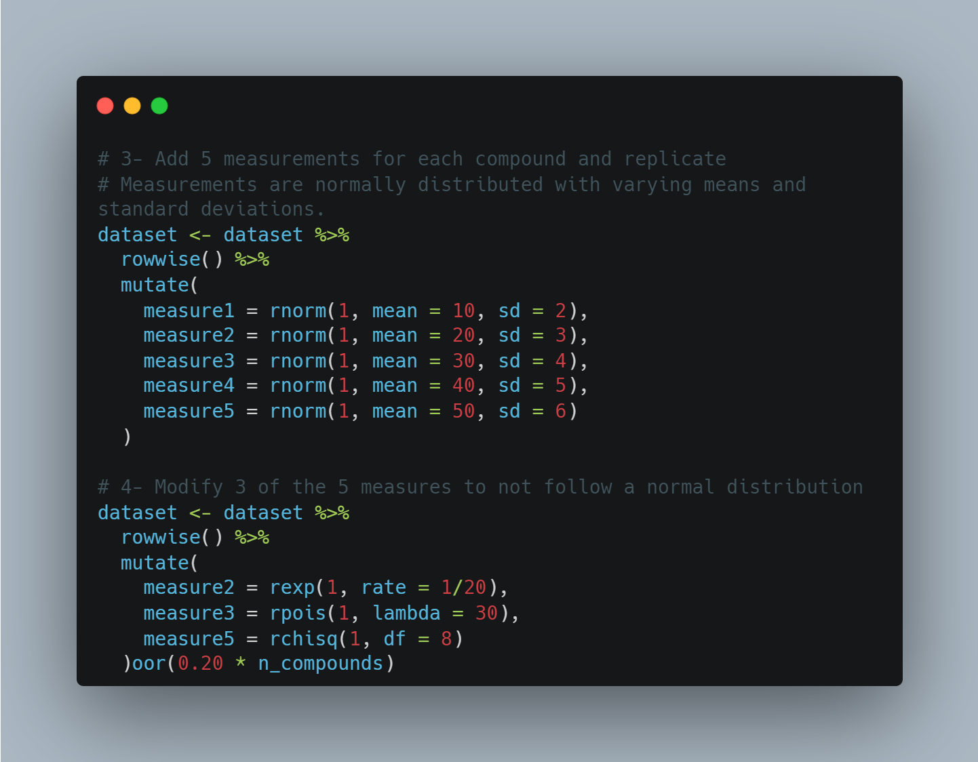
Notes:
- 5 measures (measurements) with different mean, standard deviation
- 3 out of 5 measurements must not have normal distribution (you choose them at random)

Slide 43
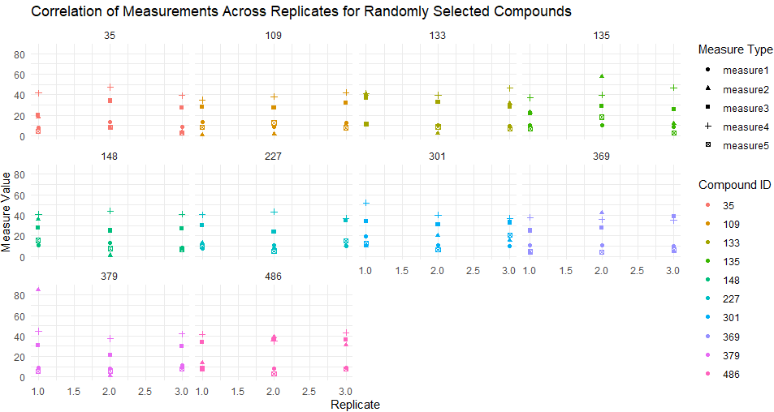
Correlated replicates
Notes:
- in the 3 replicates of each compound, the measurements must be similar to each other (within 3 standard deviations)

Slide 44
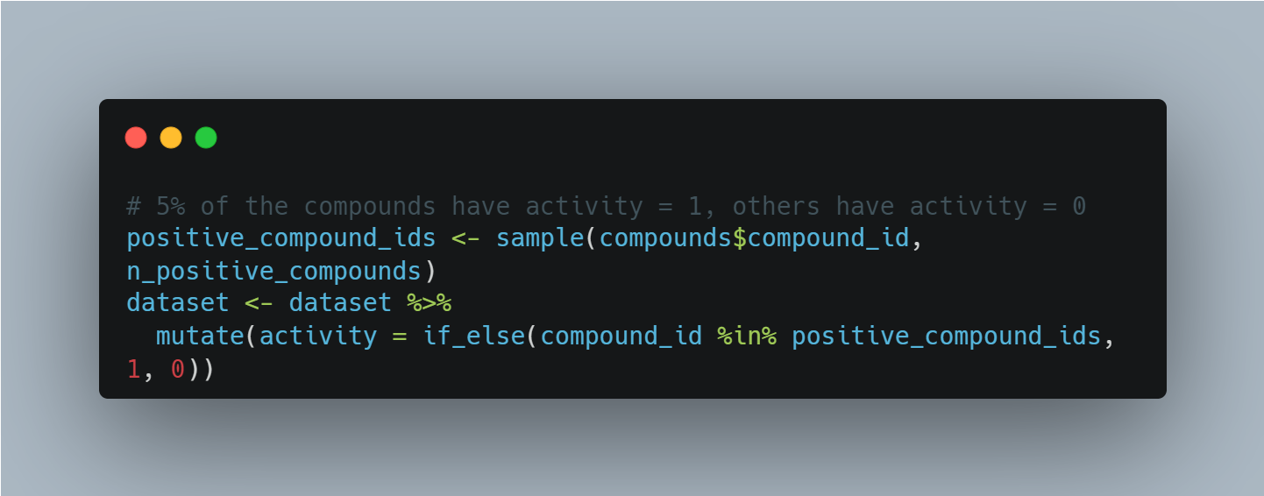
Data Generation
Notes:
- 5% of the compounds must be positive (activity = 1), the others negative (activity = 0)

Slide 45
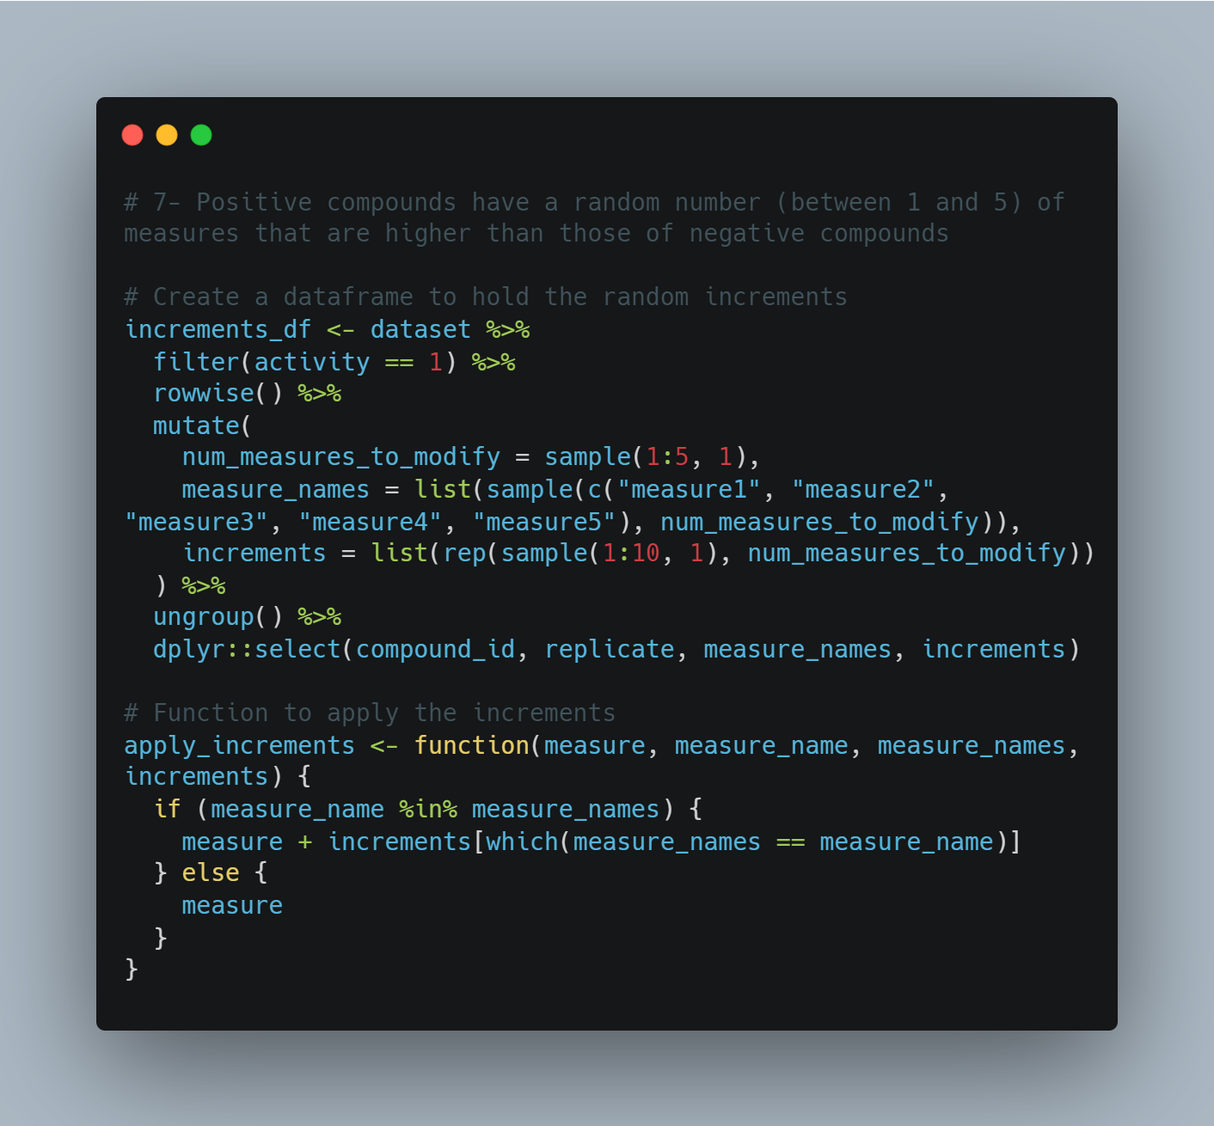
Notes:
- Compounds with activity = 1 must have min =1 and max = 5 measurements that are higher on average than compounds with activity = 0

Slide 46
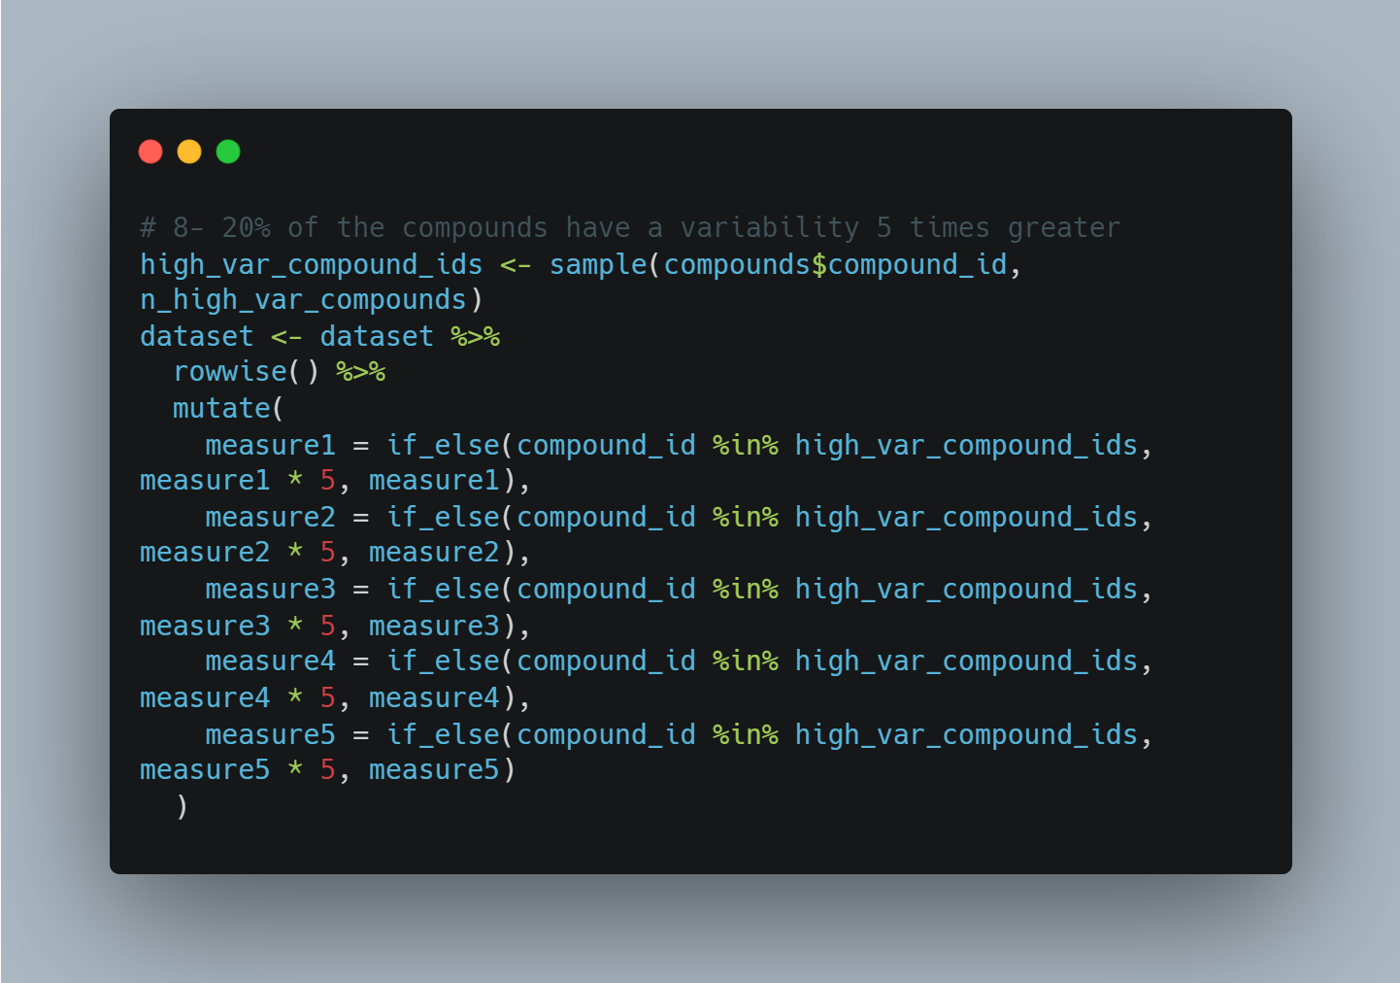
Notes:
- 20% of the compounds must have a variability greater than 5 times the others

Slide 47
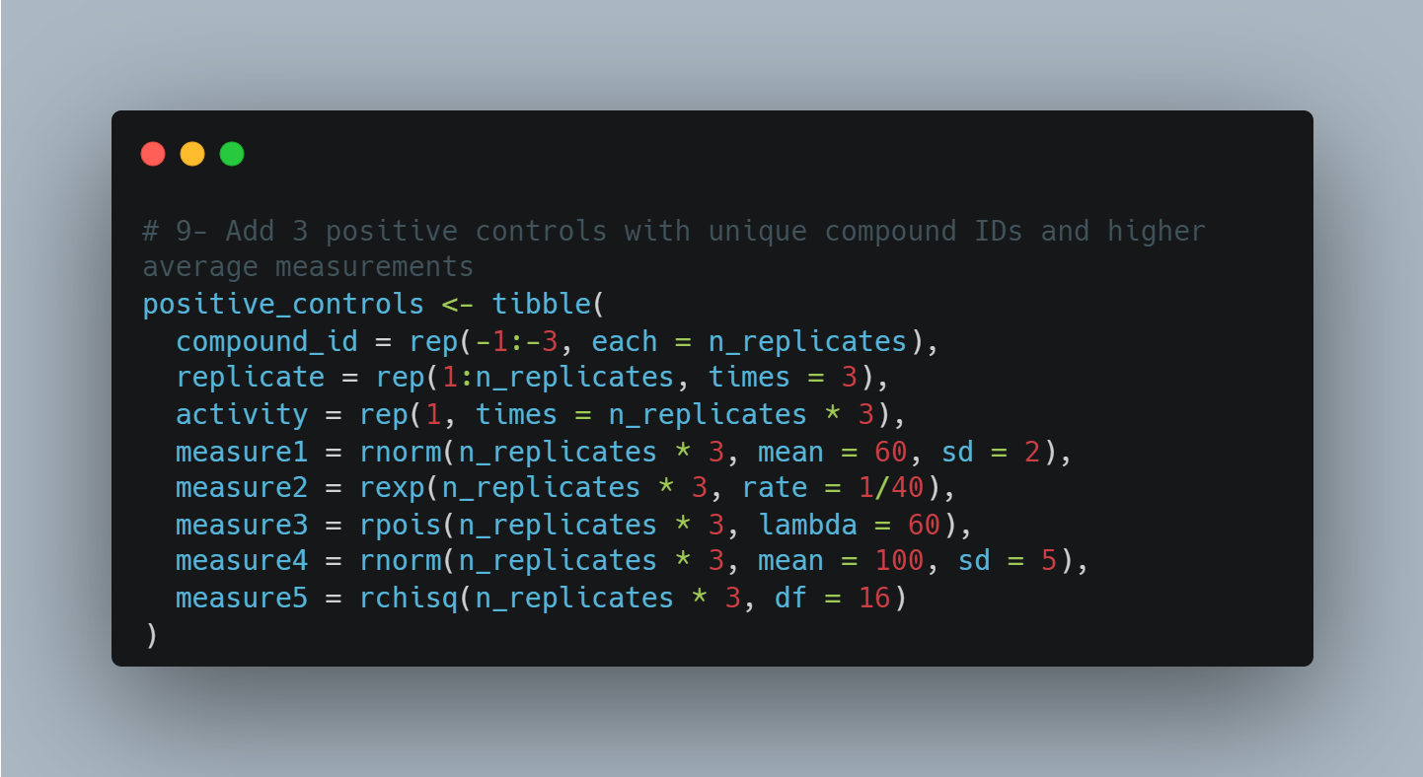
Notes:
- 3 positive controls that have all 5 measurements that are on average higher than the compounds with activity = 0

Slide 48
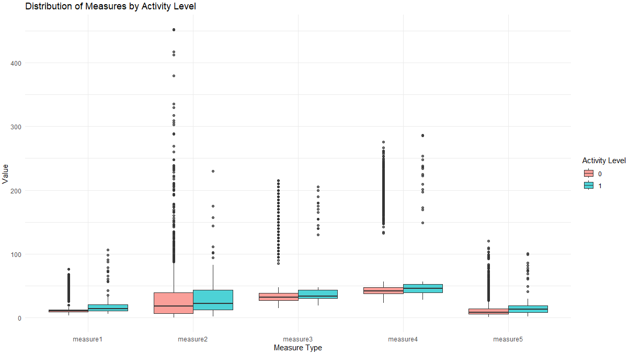

Slide 49
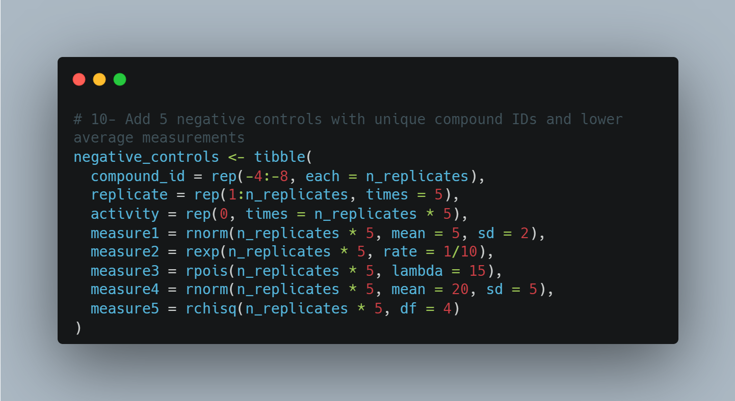
Notes:
- 5 negative controls that have all 5 measurements averaged lower than the compounds with activity = 1

Slide 50
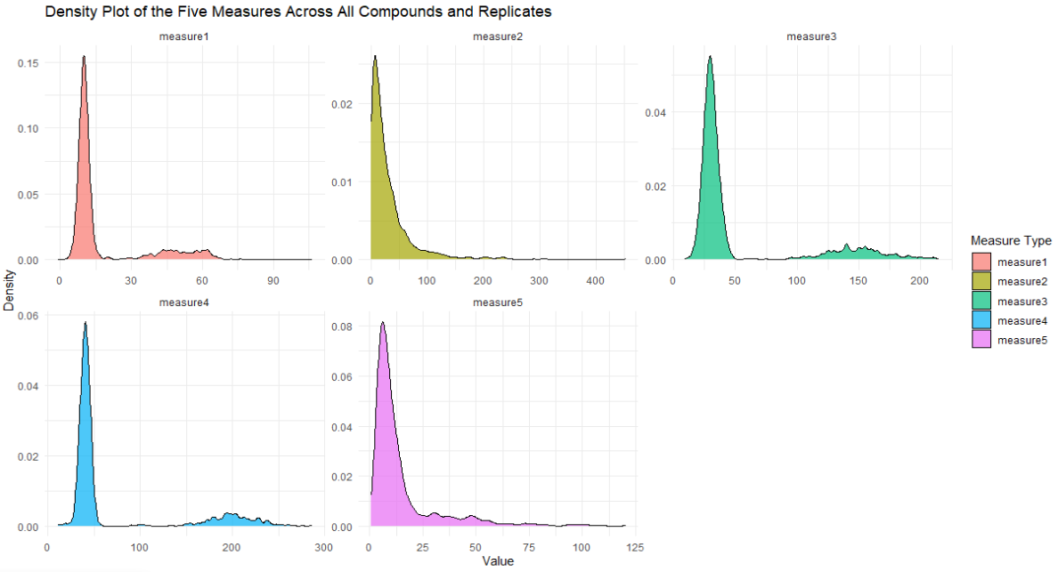

Slide 51
WHY all of that?
This dataset is a sinthetic version of the dataset I got (the Operetta one)
The ground truth is known
It’s kind of a mess...
Data were generated BEFORE employing the first model and never touched after (I swear!)

Slide 52

Performance Metrics
A single dataset (a limitation, but we see then why I did it)
10-fold cross validated
AUC as performance metric with bootstrapped 95% CI
Same seed (obviously “42”)

Slide 53
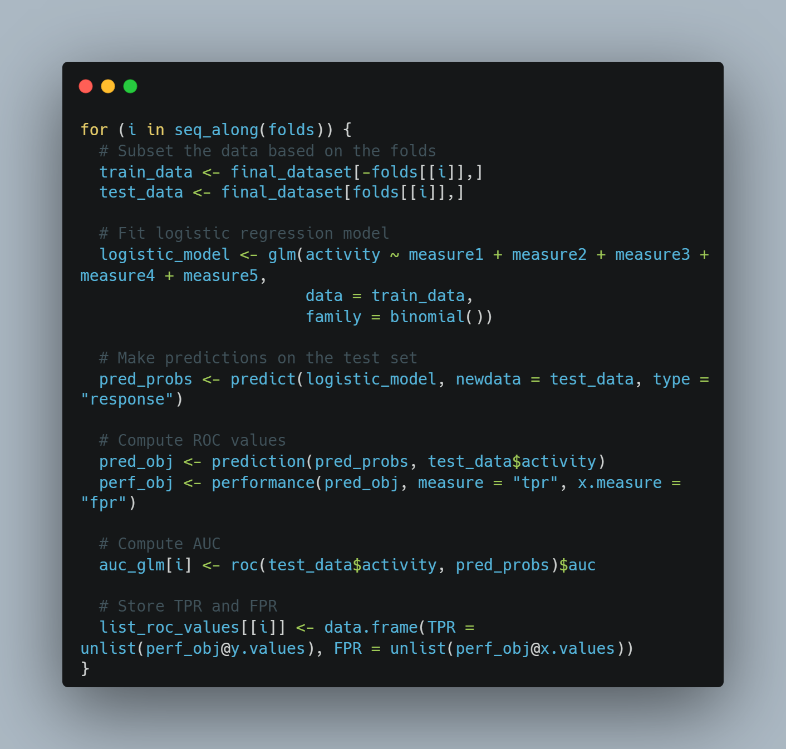
TEMPLATE FOR LOOP

Slide 54
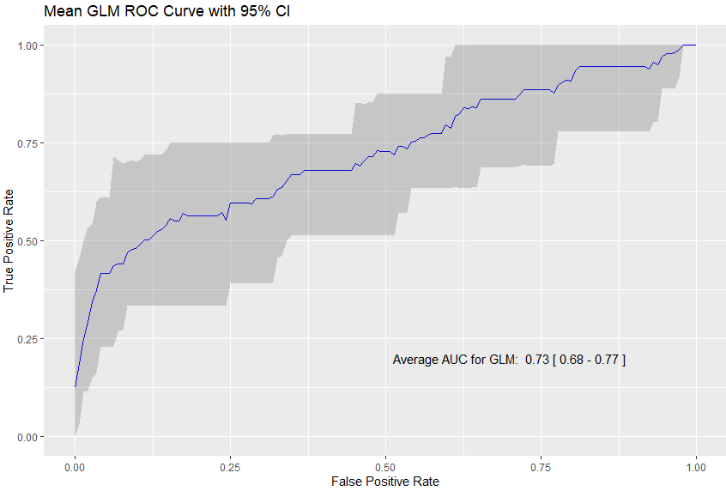
Old fashioned Logistic Regression
Mean AUC among the folds was 0.73
But it looks to have some issues with specificity
Notes:
AUC is 0.73, not bad but it looks to be sensible but not specific (kind of expected)

Slide 55
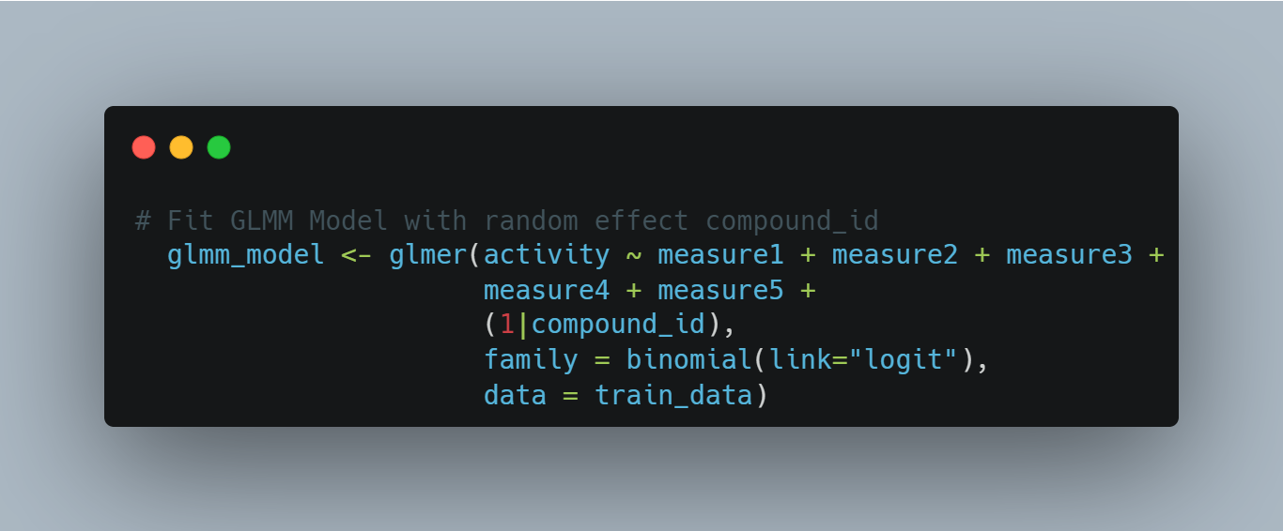
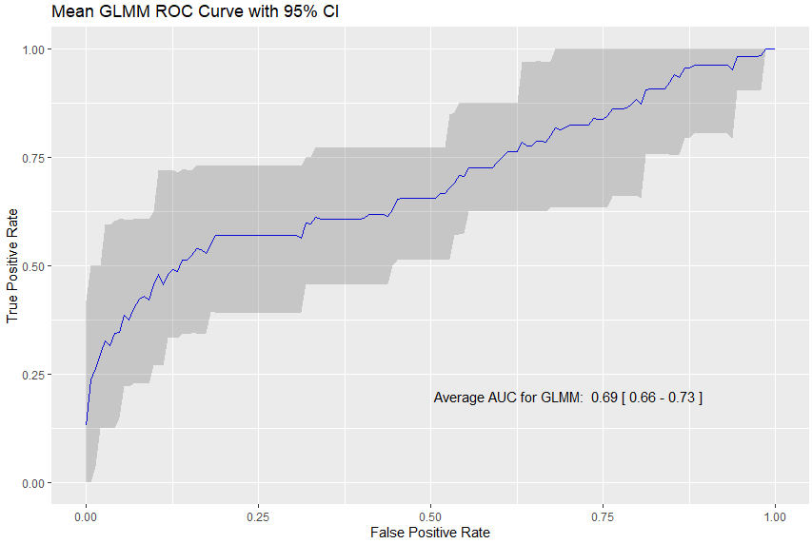
Generalized linear mixed model
GLMM can be a logical choice for HTS data (hierarchical data)
Drugs can be seen as the “centers” in which measures will vary
We can evaluate the “center effect”
VERY slow
Notes:
AUC is still aroung 0.70 probably beacuse the model still models linear relationships

Slide 56
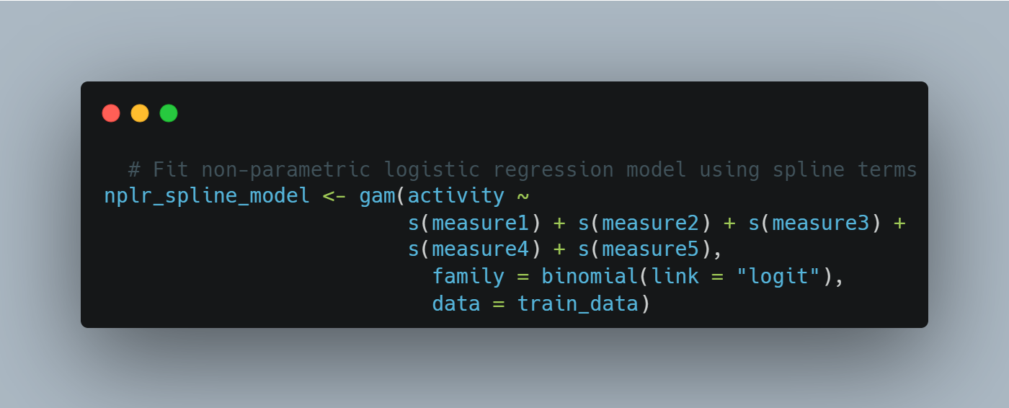
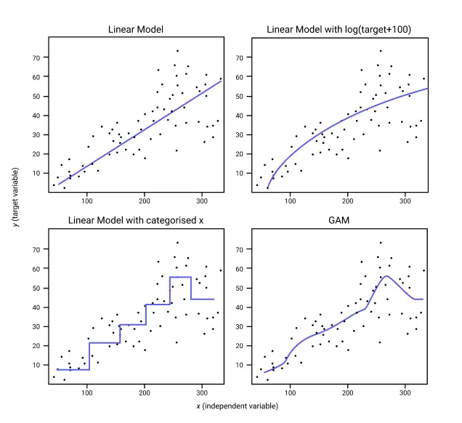
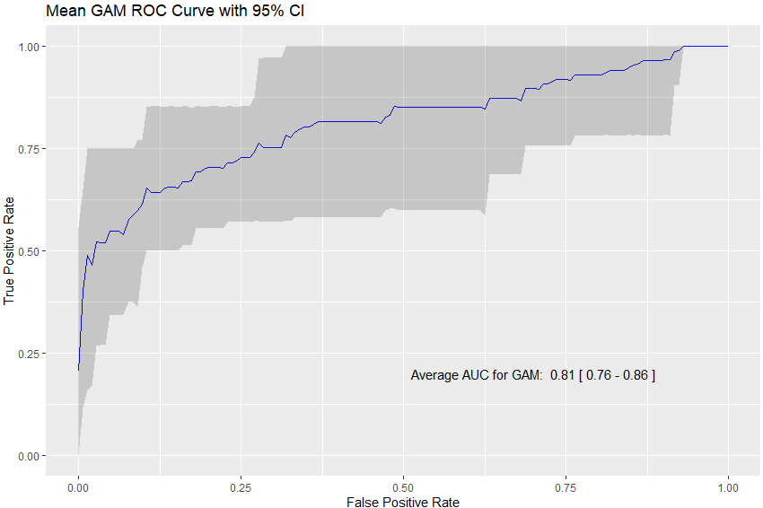
Non-Linear Model
Generalized Additive Model (GAM) + splines
Notes:
Generalised Additive Models (GAMs) are an adaptation of linear models that allows us to model non-linear data while maintaining explainability. In this example I used also some splines on the variables to account for the non-linear nature of the measures.
Taking into account the non-linear nature of the measure yield to a better predictive capacity

Slide 57
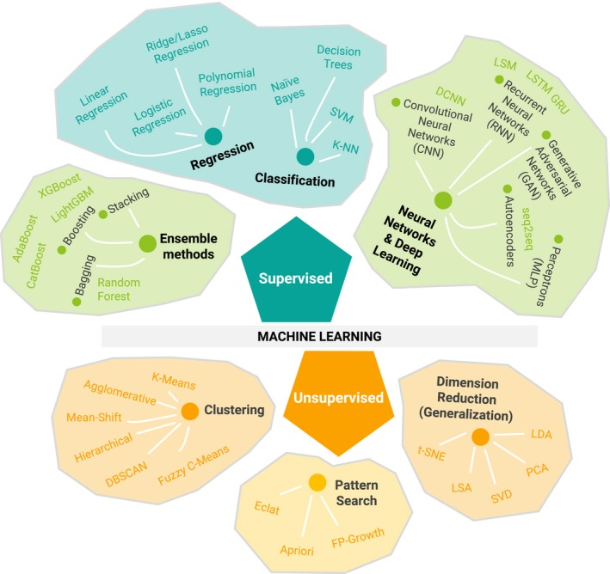
Machine learning anyone?
Logistic regression is actually already machine learning...
Are there better classifier?
Random Forest and Gradient Boosting Machines are the highest ranking classification algorithms on winning Kaggle competitions
Are they working for our purpose?
Talevi A. et al 2020

Slide 58
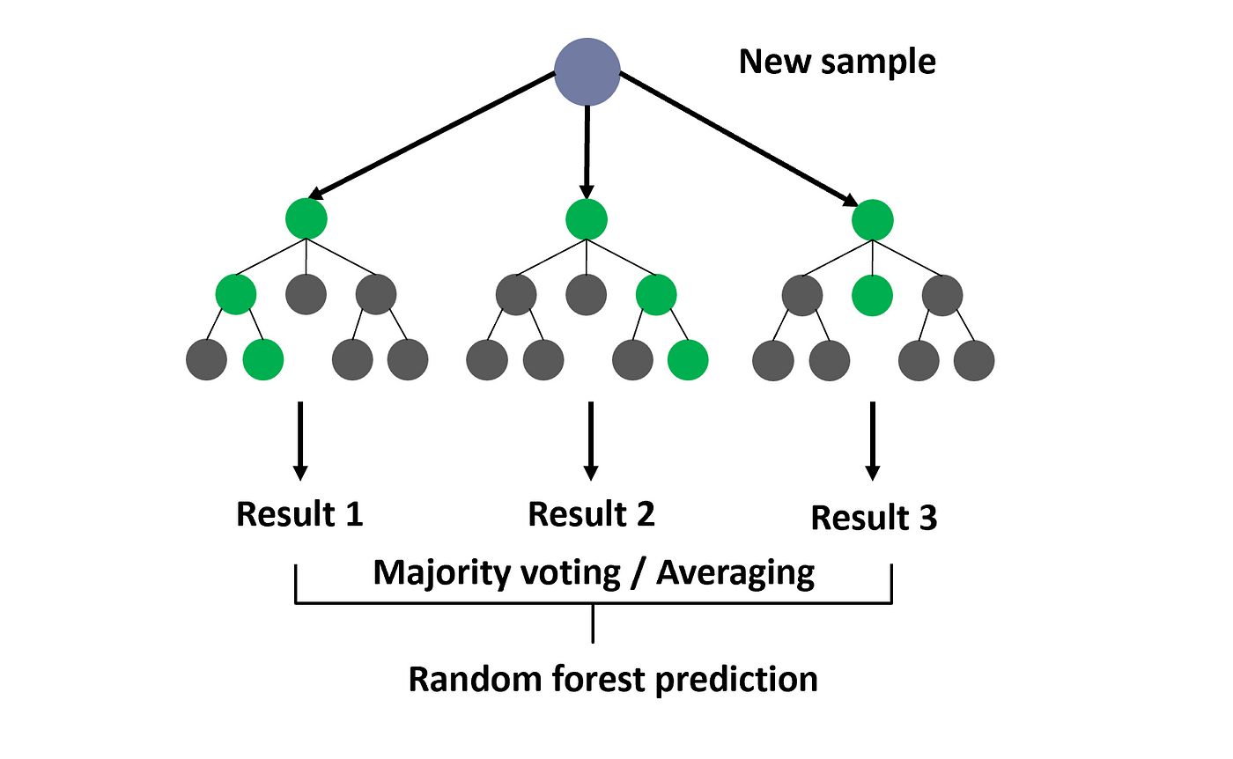
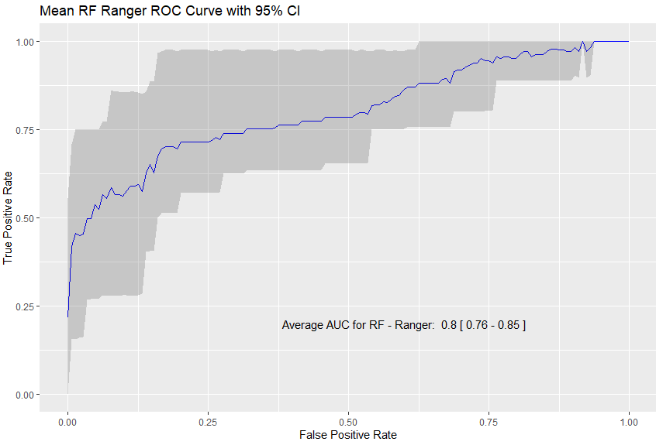
Random forest
Performances are in line with non-linear regression
The model is not optimized!
These are the performances “out-of-the-box”
Notes:
Random Forest is an ensemble learning method that operates by constructing multiple decision trees during the training phase.
The more uncorrelated the trees in the forest, the less likely the ensemble is to overfit. Random Forest can handle a variety of data types and is particularly powerful for dealing with high-dimensional data where multicollinearity may be an issue.

Slide 59
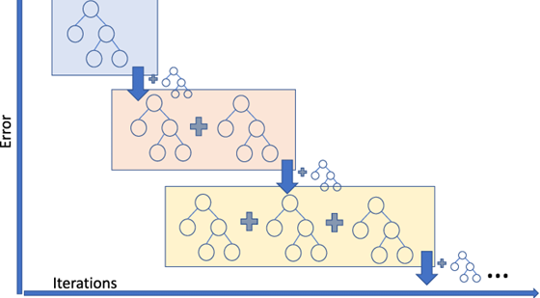
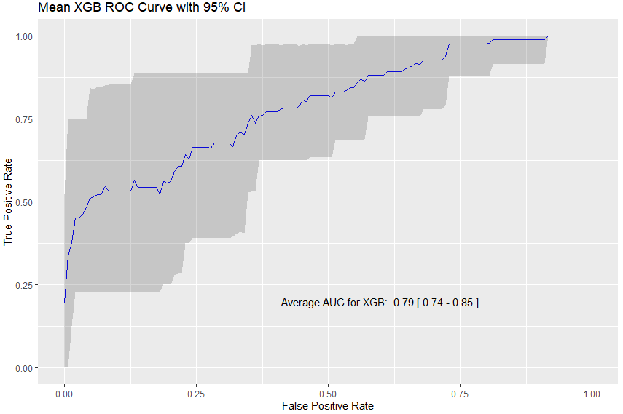
Gradient boosting machines+XGBOOSt
XGBOOST is, today, the most popular general purpose ML method to classify tabular data
It’s Kaggle top algorithm to win a competition for these kind of data
It has almost no configuration or hyperparameters setup to do before the analysis
Notes:
Gradient Boosting Machines (GBM) are part of the boosting algorithm family, which convert weak learners into strong ones.
GBM specifically optimizes for a differentiable loss function and is highly customizable, making it adaptable to various data distributions and heteroscedasticity.
XGBoost, an optimized distributed gradient boosting library, is an extension of GBM that is specifically designed to be more efficient, flexible, and portable. It offers built-in support for handling missing data and imposes a regularization term in the loss function to control over-fitting.
The results are similar to the random forest one. Nice but still not satisfactory

Slide 60

...and NOW?
Which one to use?
Which one to use after optimization?
Do I have a three year of PhD worth of doing all the tests?
Do I need this job?
What about opening a bakery?
AI generated, prompt: a man questioning its life choices working in statistics and machine learning in an impressionist style

Slide 61

“ARTIFICIAL” INTELLIGENCE
ON THE RESCUE!

Slide 62

Do you have time to speak about our lord and savior automl?
Algorithm Selection: Includes an array of algorithms such as Random Forest, Gradient Boosting Machine (GBM), and Deep Learning.
Hyperparameter Tuning: Automated tuning of model parameters using techniques like Grid Search and Random Search.
Data Preprocessing: Automatic handling of missing values and categorical variables.
Model Stacking: Enables stacking of models to improve predictive accuracy.
Interoperability: Integration with the R ecosystem; compatible with the tidyverse.
Notes:
The H2O AutoML package in R serves as a powerful tool for automating the process of model selection and hyperparameter tuning. It alleviates the need for manual intervention by encompassing a comprehensive set of machine learning algorithms and optimization techniques.

Slide 63
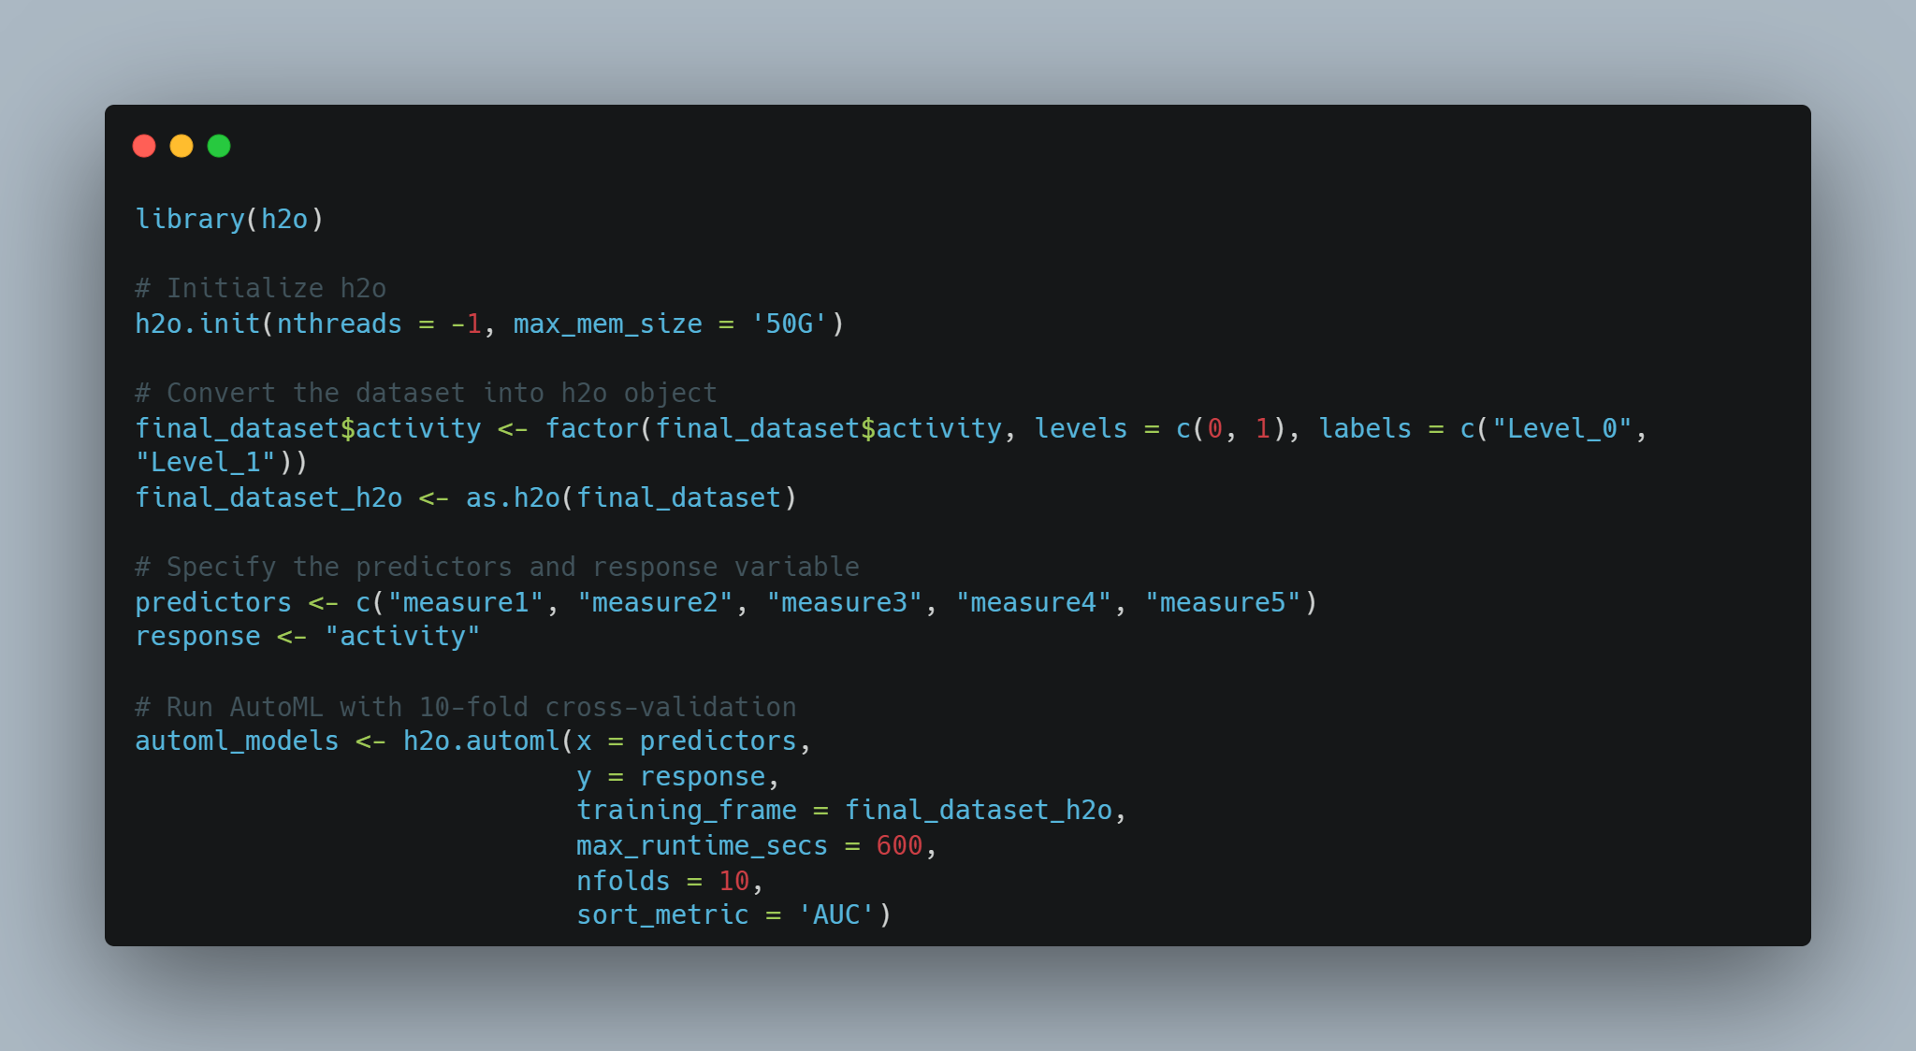

Slide 64
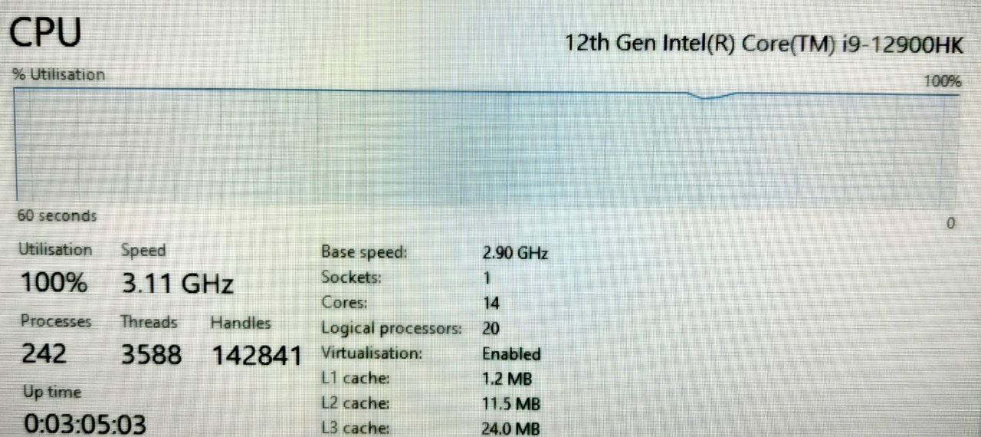
Drawbacks...
I had to take a picture because the laptop couldn’t make a screenshot...

Slide 65

...wait
NB: XGBOOST does not work on Windows.
It’s noted on the official documentation but
Rstudio server (free) + Windows Linux subsystem
works fine

Slide 66
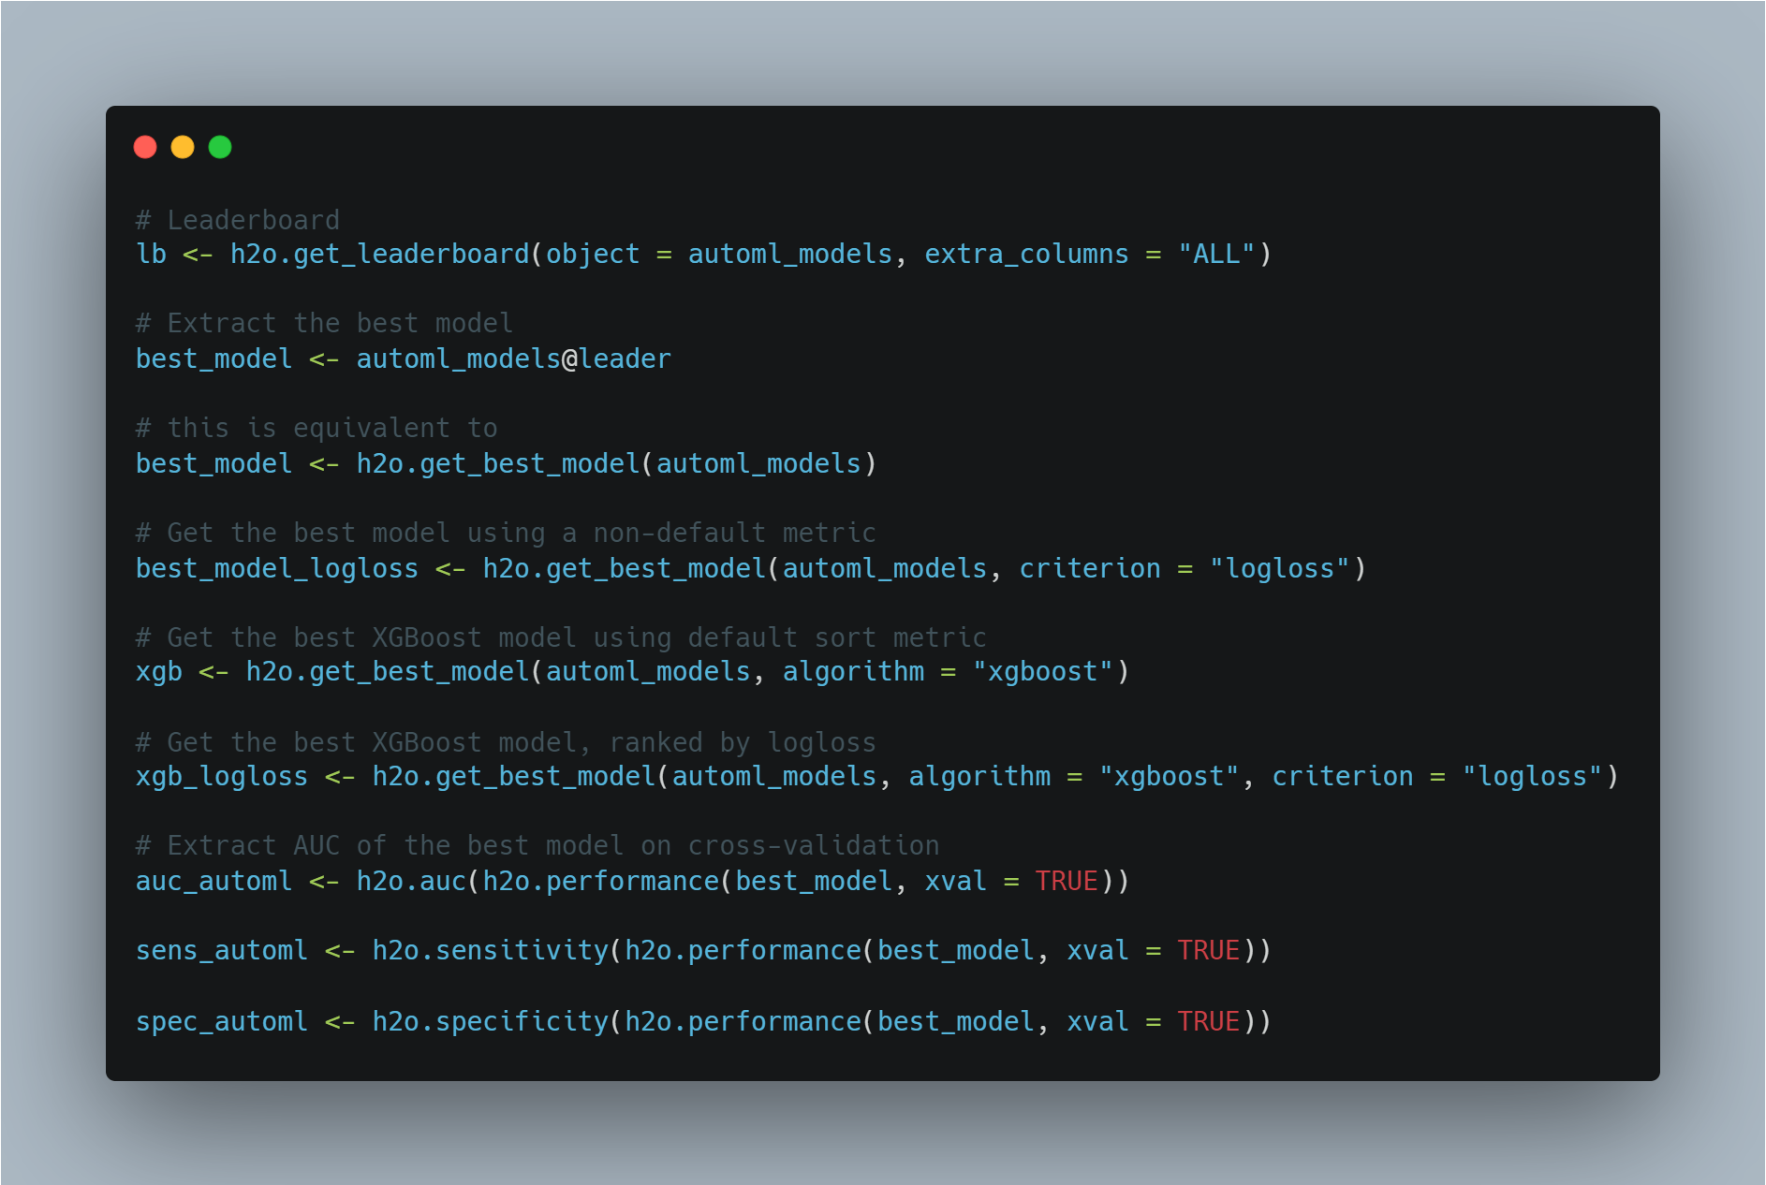

Slide 67
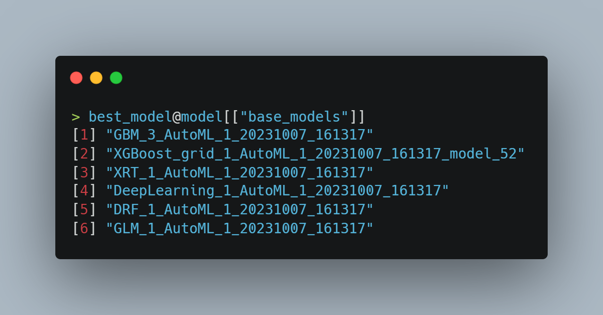
base models of the ensemble

Slide 68
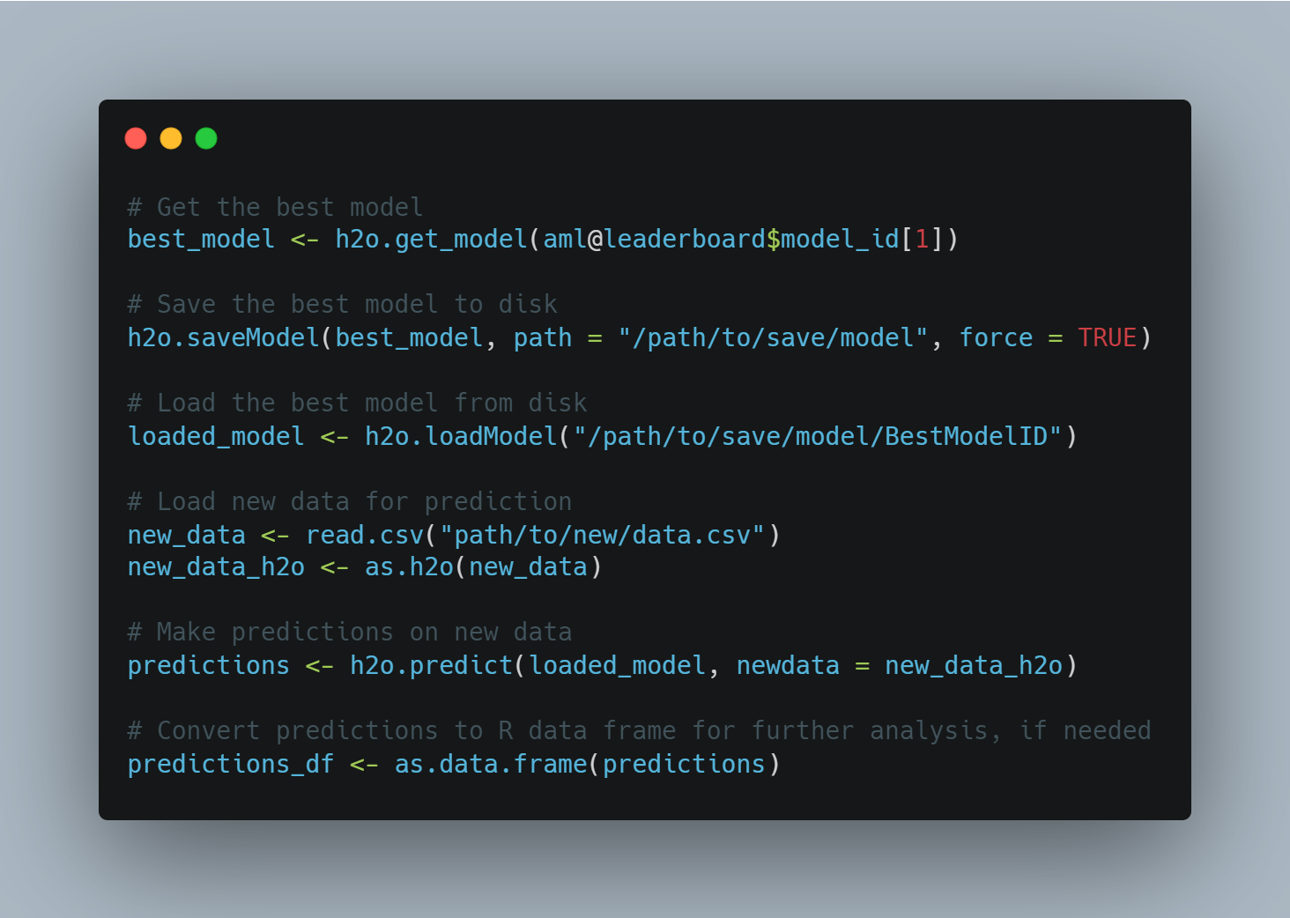
Reuse the model (for external validation)

Slide 69

Limitations
This example was more or less a toy to have an idea of the performance of various models
The data generation included a single dataset (not a reliable simulation study) but it is what we usually get
Models were intentionally not optimized. Used out-of-the-box (R packages)
But you can play with them!

Slide 70

Side note
I tried a real simulation study (1000 datasets, different SDs, different seeds, etc.)
My laptop said: no, thank you. I quit.

Slide 71



Share.your.data.and.code
Unit of Biostatistics, Epidemiology, and Public Health
University of Padova
Director: Prof. Dario Gregori
THANK YOU!
Laboratory of Statistics in Experimental Sciences
Luca Vedovelli
Sara Ahsani-Nasab (PhD Student)
lucavd/2023.HTS_presentation
Luca.Vedovelli@ubep.unipd.it

